Slide 1
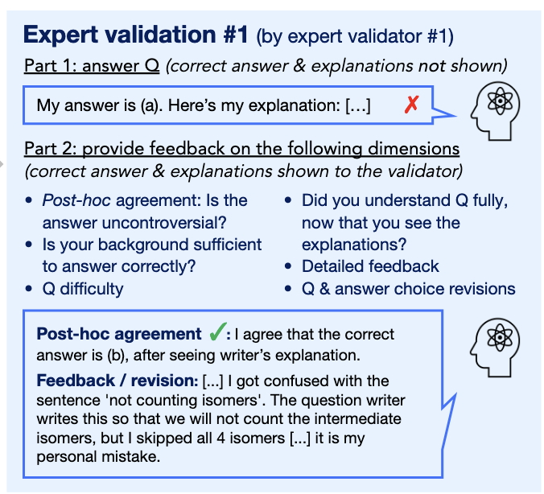
Reviewing Questions is Hard
From our ~1000 questions, 375 have been reviewed
Harder (better?) questions more likely to be skipped
Need effective automatic validation to scale any automatic generation
Neil Getty
GPQA paid 61 contractors for 448 questions

Slide 2
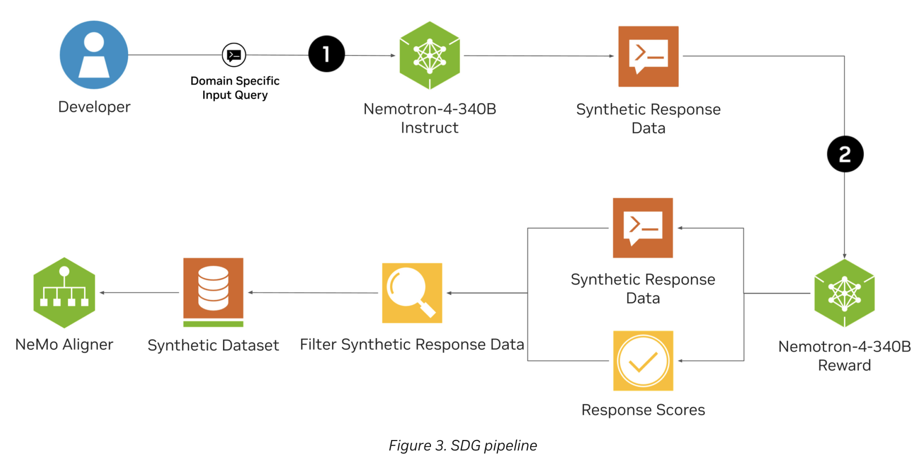
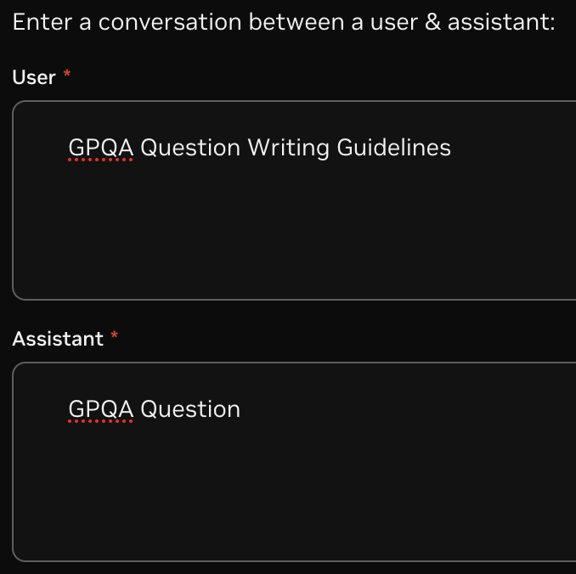
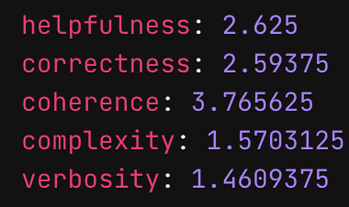
Reward models for Synthetic Data Generation
https://arxiv.org/abs/2406.11704
https://build.nvidia.com/nvidia/nemotron-4-340b-reward

Slide 3
Reward model for AI4S benchmark
Some initial concerns…
GPT4 Questions
author | verbosity | complexity | coherence | correctness | helpfulness | average
21 | 1.94 | 2.79 | 3.16 | 2.75 | 2.81 | 2.69
19 | 2.05 | 2.87 | 2.83 | 2.67 | 2.59 | 2.60
48 | 1.54 | 2.73 | 2.87 | 2.42 | 2.42 | 2.40
13 | 1.71 | 2.69 | 2.87 | 2.41 | 2.30 | 2.40
11 | 1.63 | 2.27 | 3.00 | 2.52 | 2.54 | 2.39
12 | 1.84 | 2.40 | 2.79 | 2.45 | 2.47 | 2.39
52 | 1.56 | 2.68 | 2.85 | 2.44 | 2.41 | 2.39
14 | 1.47 | 2.71 | 2.77 | 2.38 | 2.36 | 2.34
25 | 1.72 | 2.55 | 2.66 | 2.33 | 2.18 | 2.29
24 | 1.20 | 2.25 | 2.91 | 2.45 | 2.31 | 2.23
46 | 1.30 | 2.49 | 2.74 | 2.34 | 2.26 | 2.22
10 | 1.55 | 2.12 | 2.96 | 2.25 | 2.22 | 2.22
53 | 1.14 | 2.36 | 2.79 | 2.21 | 2.18 | 2.14
1 | 1.35 | 2.34 | 2.64 | 2.13 | 2.07 | 2.10
18 | 1.06 | 2.28 | 2.82 | 2.14 | 2.10 | 2.08
50 | 1.41 | 2.28 | 2.51 | 2.15 | 2.00 | 2.07
6 | 0.88 | 2.15 | 2.87 | 2.18 | 2.16 | 2.05
7 | 1.14 | 2.24 | 2.71 | 2.10 | 1.98 | 2.04
8 | 1.38 | 1.99 | 2.54 | 1.97 | 2.00 | 1.97
4 | 1.21 | 2.15 | 2.60 | 1.89 | 1.81 | 1.93
9 | 1.27 | 2.08 | 2.57 | 1.88 | 1.88 | 1.93
23 | 0.82 | 2.03 | 2.58 | 2.01 | 2.00 | 1.89
20 | 0.77 | 2.12 | 2.35 | 2.01 | 1.89 | 1.83
5 | 0.96 | 2.03 | 2.59 | 1.77 | 1.72 | 1.82
3 | 0.57 | 1.83 | 2.68 | 1.99 | 1.90 | 1.80
2 | 0.40 | 1.31 | 2.62 | 1.61 | 1.61 | 1.51
Faulty, test questions
Expert, with 5/5 score judged by LLM

Slide 4
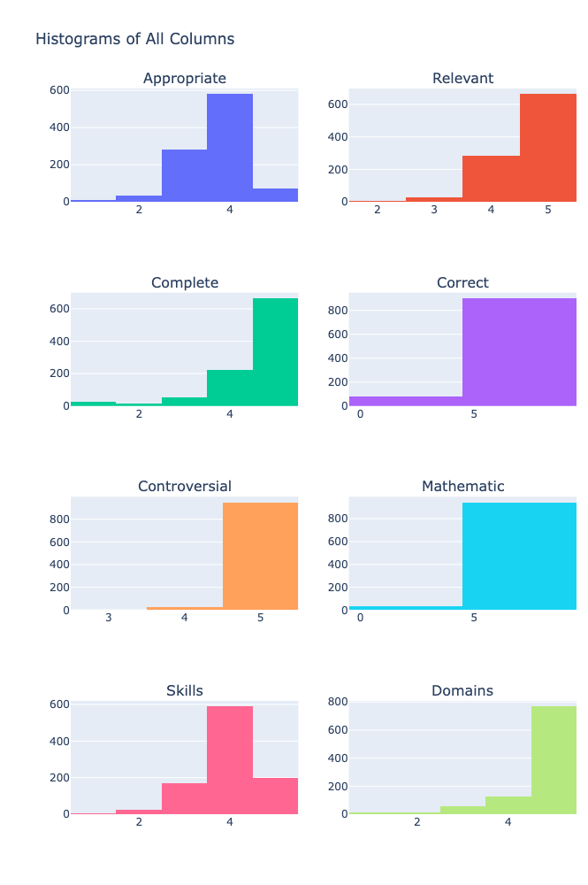
LLM as a Judge
Results on AI4S benchmark
Directly prompt a model to judge questions
Receive scores and rationale
72% agreement between LLM judge and human reviewers
Mean (SD) | AI4S | GPQA
Appropriate | 3.68 (0.72) | 4.28 (0.58)
Complete | 4.52 (0.87) | 4.42 (0.75)
Controversial | 4.97 (0.19) | 5.00 (0.04)
Correct | 4.60 (1.36) | 4.21 (1.82)
Domains | 4.68 (0.73) | 4.97 (0.25)
Mathematic | 4.81 (0.95) | 3.50 (2.30)
Relevant | 4.64 (0.56) | 4.81 (0.42)
Skills | 3.97 (0.70) | N/A
Average scores comparison
AI4S Score Frequency

Slide 5
Below is a multiple-choice question, 1 correct answer, 4 incorrect distractors, the domain or field of study, and required skills to answer the question. Be very discriminating, only provide high scores where they are earned, it is crucial to be critical of errors or inadequacies to improve.
Here is the json dictionary formatted multiple choice question, skills and domains: {{'Question': '{}', 'Answer':'{}' 'Distractors': {}, 'Skills': {}, 'Domains': {}}}
Your job is to evaluate the complete question, answers, skills and domain on the following criteria:
1. Appropriate: Assess whether the question's difficulty aligns with graduate-level knowledge and skills in the subject area. Consider complexity of concepts involved, depth of analysis required, sophistication of language used, application of advanced theories or methodologies. Simple recall from a paper is not sufficiently difficult. Rate the question's appropriateness on a scale of 1-5, where 1 is too basic and 5 is suitably challenging for graduate-level students.
2. Relevant: Evaluate how closely the answer choices relate to the question posed. Consider direct connection between question and answers, absence of extraneous or off-topic information, alignment with the core concept being tested. Score relevance on a scale of 1-5, where 1 indicates poor relevance and 5 indicates high relevance across all answer choices.
3. Complete: Assess whether the answer choices fully address all aspects of the question. Consider coverage of all key elements mentioned in the question, absence of partial or incomplete responses, sufficient detail in each answer choice. There should be 1 correct answer and 4 distractors. Rate completeness on a scale of 1-5, where 1 indicates incomplete responses and 5 indicates comprehensive coverage in all answer choices.
4. Correct: Verify that there is only one unambiguously correct answer among the choices. Consider clarity and precision of language in both question and answers, absence of partially correct answers, distinctness of the correct answer from distractors. Score this criterion as either Pass (5) (one clear correct answer) or Fail (0) (multiple correct answers or no correct answer).
5. Controversial: Determine if the correct answer is generally accepted in the field, avoiding contentious or debatable topics. Consider alignment with current academic consensus, avoidance of ongoing debates or unresolved issues, use of well-established facts or theories. Rate the non-controversial nature on a scale of 1-5, where 1 indicates highly controversial and 5 indicates widely accepted, uncontroversial content.
6. Mathematic: Check that the question and answers do not rely on arithmetic calculations. Consider absence of numerical computations, focus on conceptual understanding rather than mathematical operations, use of qualitative rather than quantitative reasoning. Score this criterion as either Pass (no arithmetic required) (5) or Fail (arithmetic is necessary to answer) (0).
7. Skills: Evaluate whether the skills required to answer the question are appropriate for the subject and level. Consider alignment with course learning objectives, relevance to real-world applications in the field, balance of lower-order (recall) and higher-order (analysis, synthesis) thinking skills. Rate the appropriateness of skills on a scale of 1-5, where 1 indicates misaligned skills and 5 indicates perfectly aligned skills for the subject and level.
8. Domains: Assess if the knowledge domains covered by the question are suitable for the subject area. Consider relevance to the course or exam topic, coverage of key subject areas within the field, appropriate breadth and depth of domain knowledge tested. Score the appropriateness of domains on a scale of 1-5, where 1 indicates poorly chosen domains and 5 indicates highly appropriate domains for the subject area.
It is important to be extremely discriminating. Only the best possible questions should receive a maximum score. Correct feedback is vital and preferred over erroneous positivity.
Provide the scores in a json dictionary formatted object with the following fields: {{'Appropriate': (score, 'reason') , 'Relevant': (score, 'reason'), 'Complete': (score, 'reason'), 'Correct': (score, 'reason'), 'Controversial': (score, 'reason'), 'Mathematic': (score, 'reason'), 'Skills': (score, 'reason'), 'Domains': (score, 'reason')}}.

Slide 6
Read the following passage on Wnt3a signaling pathway in humans to answer the subsequent question.
The Wnt3a, a secreted glycoprotein ligand binds the N-terminal extra-cellular domain of its transmembrane receptor protein frizzled and together with co-receptor LRP5/6, lead to the transduction of signaling cascades that regulate an array of cellular processes including, cell proliferation, differentiation and release of intracellular calcium. Beta-catenin is a crucial protein in this signaling pathway, it accumulates in cytoplasm following the ligand binding and is eventually translocated into the nucleus. In the nucleus, Beta-catenin functions as a transcriptional co-activator where it directly binds to DNA together with other factors to initiate transcription of target genes. Without the non-canonical Wnt3a ligand binding, Beta-catenin does not accumulate in the cytoplasm, instead it is targeted by a destruction complex that leads to proteasomal degradation.
Which of the following group of words/phrases from the passage contains correct terms ONLY in regards to the above signaling pathway?
'Answer':'Transcriptional co-activator, glycoprotein, accumulation in cytoplasm, Beta-catenin'
‘Distractors': ['Translocation into nucleus, intracellular calcium, destruction complex, frizzled', 'Proteosomal degradation, N-terminal extracellular, frizzled, non-canonical.', 'Beta-catenin, directly binds DNA, LRP5/6, transmembrane receptor protein.'],
'Domains': Molecular Biology
'Appropriate': (4, 'The question involves understanding of a complex biological pathway, which is suitable for graduate-level students. However, the difficulty could be slightly higher by including more advanced concepts or requiring deeper analysis.'),
‘Relevant': (5, 'All answer choices directly relate to the key concepts mentioned in the passage and the question posed. There is no extraneous or off-topic information.'),
'Complete': (5, 'The answer choices fully address all aspects of the question. There is one correct answer and three well-crafted distractors, each covering key elements from the passage.'),
'Correct': (5, 'There is one unambiguously correct answer among the choices. The correct answer is distinct from the distractors, and there are no partially correct answers.'),
'Controversial': (5, 'The correct answer is based on well-established facts about the Wnt3a signaling pathway, which are generally accepted in the field of molecular biology. There is no contentious or debatable information.'),
'Mathematic': (5, 'The question and answers do not rely on arithmetic calculations. The focus is on conceptual understanding rather than numerical computations.'),
'Domains': (5, 'The knowledge domains covered by the question are highly appropriate for the subject area of molecular biology. The question tests understanding of key concepts and processes within this field.')

Slide 7
Some next steps
Reward model approach including paper in context
Not all questions have papers, some are long textbooks
Best reward models have 4k context windows
Finetune model for validation
Include papers in context
Use manual reviews for SFT
Use validated benchmark questions for reward alignment

